Slide 1
Civil Rights- What You Need to Know
Ryan Warner
Community Liaison- Civil Rights
Washington State Department of Public Transportation
Public Transportation Office

Slide 2
The Americans with Disabilities Act
The Americans with Disabilities is civil rights legislation which requires that a person with disabilities receive transportation services equal to those available on the fixed route.
This also includes all public spaces such as transit centers, administrative offices and outlets where schedule information or passes are sold.
This also includes ensuring your electronic communication is accessible.
This also includes your primary written materials.

Slide 3
Routing Structures
Fixed Route: A route with fixed start and ending points, specific stops and a consistent route.
Requires paratransit services ¾ mile off the fixed route to serve people with disabilities.
Deviated Fixed Route: A fixed route that departs from the published route at certain points. Must be used to pick up passengers with and without disabilities.
Demand Response: Characterized by smaller vehicles that travel on diverse routes primarily in Suburban and Rural communities

Slide 4
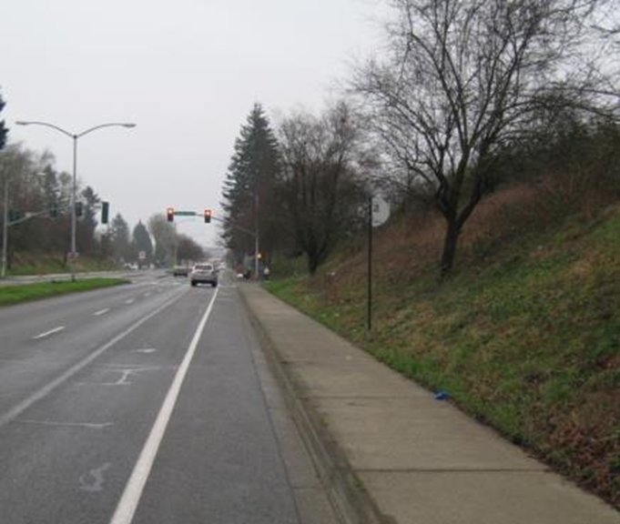
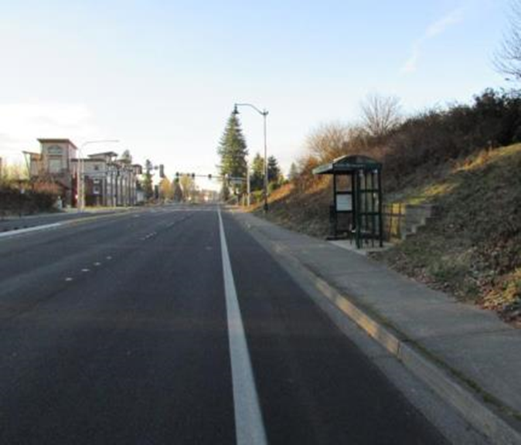
Fixed Route Accessibility
Commitment to ongoing bus stop accessibility improvements
Before
After
Notes:
ADA Transportation Requirements:
Accessibility of all new transportation facilities & vehicles used in Fixed Route
Equivalent Access to Demand Response Services
Complementary Paratransit Service must extend a minimum of ¾ mile beyond the boundaries of the Fixed Route System
Taking all of the accessible features the ADA brought to transit to bring greater independence to peoples’ lives.

Slide 5
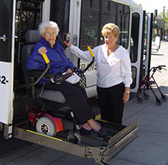
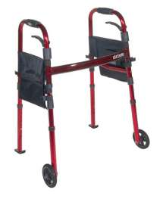

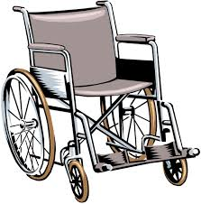

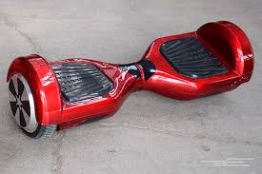
What is a Personal Mobility Device?

Slide 6
So what is the definition?
A mobility aid belonging to any class of 3 or more wheeled devices, Usable indoors, Designed for use by individuals with disabilities
Weight of device + occupant must not exceed lift capacity
Wheelchair does not need footrests, brakes, push handles or harnesseses
The transit agency can deny a rider if doing so would cause a legitimate safety concern
The transit agency is not required to transfer wheelchairs in non securement areas
Riders can choose to board in any direction & separately from the device

Slide 7
Walkers, Canes and Crutches
Persons with mobility disabilities may use canes, crutches, and walkers on the same basis as wheelchairs
Transit agencies are not required to accommodate devices not primarily designed for use by individuals with mobility impairments or permit other types of assistive devices to be used in ways that depart from or exceed their intended uses (walkers to be sat on)*

Slide 8
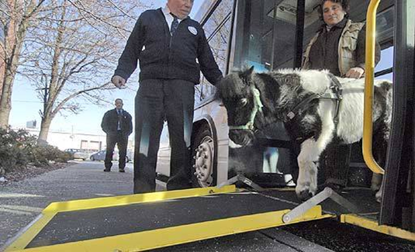
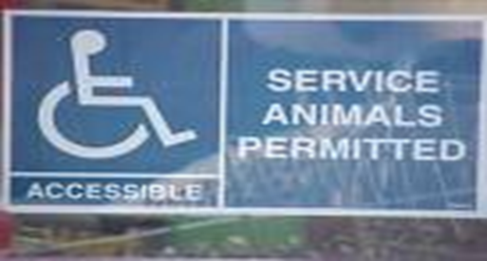
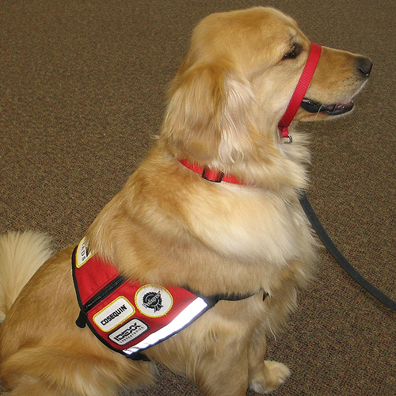
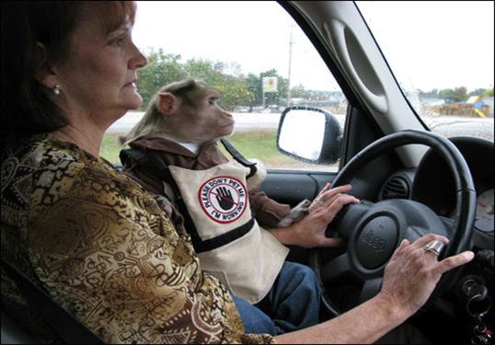
Service Animals

Slide 9
Service Animals Continued…
Service Animal is any guide dog, signal dog, or other animal individually trained to perform a task or service for an individual with a disability
Operators can ask two questions…
Is this a service animal
What service do they provide
Service Animals do not need to be professionally trained, wear a harness or collar, or be certified
Allergies do not trump service animal law
No limit on the amount of service of animals

Slide 10
What kind of tasks can a service animal do?
Guiding an individual who is blind
Alert a Deaf individual to intruders or sounds
Pull a wheelchair
Fetching dropped items
Remind someone to take prescribed medications
Get a person out of a situation that could cause an episode (ex: seizures)

Slide 11
Responsibility of Riders
Animals must be on a leash or in a container
Animals must remain under control of the owner
Animals must behave appropriately
Animals must not be aggressive toward people or other animals
Drivers are not required to take charge of service animal
Notes:
Riders must control their service animals or service can be suspended

Slide 12
Direct Threat
Transit agencies may refuse to transport service animals that are deemed to pose a direct threat to the health or safety of drivers or other riders, create a seriously disruptive atmosphere, or are otherwise not under the rider’s control.
Transit agencies must provide justification for making a direct threat claim

Slide 13
Reasonable Modification
Public entities that provide public transportation shall make reasonable modifications in policies, practices, or procedures when the modifications are necessary to avoid discrimination on the basis of disability or to provide program accessibility to their services, subject to the limitations of.
Public entity must information must public how to make requests for reasonable modifications. This must readily available to the public through the same means it uses to inform the public about its policies and practices.
Whenever feasible, requests for modifications shall be made and determined in advance, before the transportation provider is expected to provide the modified service.
WSDOT has policy language in its template policy to guide you

Slide 14

Communication

Slide 15
Stop Announcements
On fixed route systems, the entity shall announce stops as follows:
At transfer points with other fixed routes
Major intersections and destination points,
Intervals along a route sufficient to permit individuals with visual impairments or other disabilities to be oriented to their location.
Transit shall announce any stop on request of an individual (with or without a disability)
Notes:
Stop announcements benefit all riders, but failing to announce stops can present significant challenges to some riders in knowing when to get off the vehicle
The announcement can be made personally by the vehicle operator or can be made by a recording system.
Many transit systems include the following types of locations for stop announcements, as applicable:
• Time points and cross streets published in schedules and on route maps
• Public facilities such as government offices, libraries, and schools
• Medical facilities
• Stores and shopping malls
• Cultural and entertainment venues
• Other popular destinations
Significant intervals is not defined
Transit agencies must ensure stop announcements are clear, audible, and timely in order for them to be effective:
• Clear announcements enable riders unfamiliar with the route and neighborhood to understand the name of the stop.
• Audible announcements enable riders to hear the announcement from any location within the bus or train.
• Timely announcements provide riders with sufficient time to press the stop request device to enable drivers to stop at a desired location.

Slide 16
Accessible Information
An entity shall make available to individuals with disabilities adequate information concerning transportation services. This obligation includes making adequate communications capacity available, through accessible formats and technology, to enable users to obtain information and schedule service
Notes:
Accessible Formats include large print, Braille, audiotape.
Information “does not necessarily need to be made in the format a requester prefers, but it does have to be made available in a format the person can use (ie; if a person cannot read braile)
While the DOT ADA regulations do not set standards for website accessibility, FTA suggests that agencies review DOJ guidance under Section 508 and the Rehab AcT
TTY/TTD=711 relay
State Contract

Slide 17
Why Website ADA Accessible
The Web must be accessible to provide equal access and equal opportunity to people with diverse abilities.
Accessibility supports social inclusion for people with disabilities as well as others, such as older people, people in rural areas, and people in developing countries
Business Case for Accessibility: Studies show that accessible websites have better search results, reduced maintenance costs, and increased audience reach
There are a wide variety of disabilities and a variety of changes to your website to make them more accessible

Slide 18
There is oh so much more…
For additional questions on all things civil rights please contact:
Ryan Warner
Community Liaison- Civil Rights
warnerry@wsdot.wa.gov
360-705-6918

