Slide 1

April 24, 2018
ADA Issues & Solutions Workshop 2018
Personal Safety
Mark Solomon, CPD
Crime Prevention Coordinator
Seattle Police Department

Slide 2
Workshop Overview
Needs Assessment – your safety concerns
Discussion of Personal Safety Principles, The 5 A’s:
  Attitude, Awareness, Assessment, Action, & Aftermath
Safety Tips By Location or Activity
Reporting Crime and Suspicious Behaviors

Slide 3
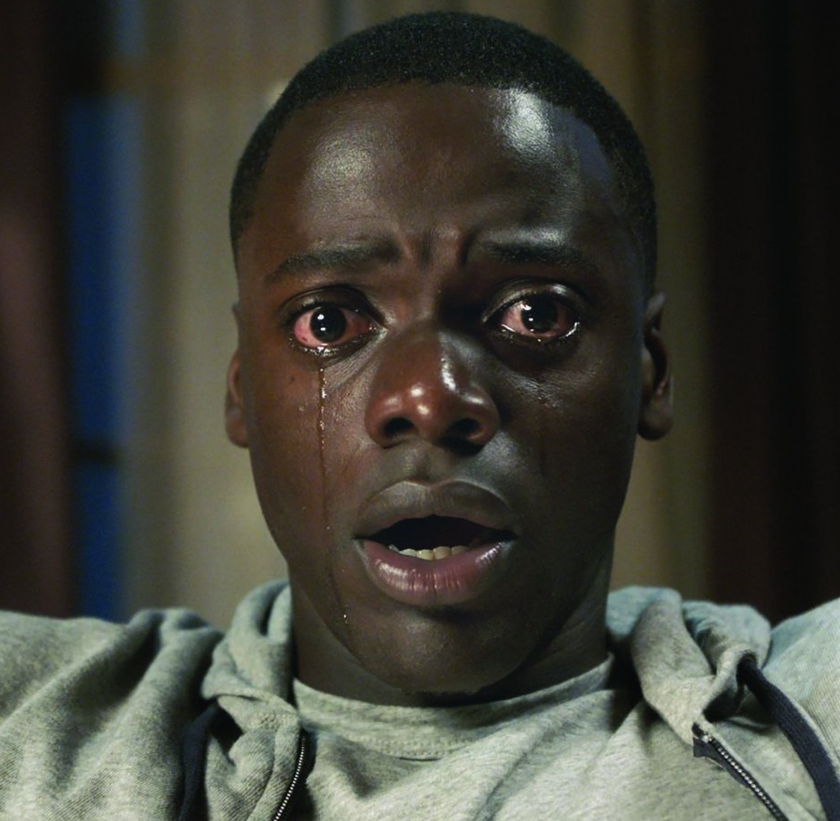
Needs Assessment
What are your safety concerns?

Slide 4
Personal Safety Principles
The 5 A’s
Attitude
  Awareness
    Assessment
      Action
        Aftermath
The 5 A’s - © Obsidian Security Group, Inc. 2007

Slide 5

Attitude
Mindset: begins when you wake up in the morning, not when you’re being attacked
Not just external projection, an internal mind speak
Decision not to be a victim
Body language, nonverbal communication: What are you projecting? How do you carry yourself?
  Confident, aware person
  Meek, timid victim
How do you carry your belongings?
The 5 A’s - © Obsidian Security Group, Inc. 2007
Notes:
Anytime you move from something over which you have direct control or influence to one that you don’t, your personal safety is impacted. Mindset, attitude runs throughout any personal safety approach.
Planning, Preparation and Practice significantly reduce the risks to your personal safety
Are you ready for your day? For your tasks?
Work hours
Transportation
Clothing
Destinations
Mental Preparation - begins when you wake up in the morning, not when you’re being attacked
Importance of mental preparation
Decision not to be a victim

Slide 6

Attitude
Planning, Preparation & Practice significantly reduce the risks to your personal safety
Keep a running game plan; Keep it simple
Plan ahead, but be flexible
  Are you ready for your day? For your tasks?
  Work hours / Transportation / Clothing / Shoes
  Where are you going? Going alone?
  What will you be doing?
  What do you need to have with you?
  Who knows where you are/will be?
  What will you do if……?
The 5 A’s - © Obsidian Security Group, Inc. 2007
Notes:
Planning, Preparation and Practice significantly reduce the risks to your personal safety
Are you ready for your day? For your tasks?
Work hours
Transportation
Clothing
Destinations
Mental Preparation - begins when you wake up in the morning, not when you’re being attacked
Importance of mental preparation
Decision not to be a victim

Slide 7
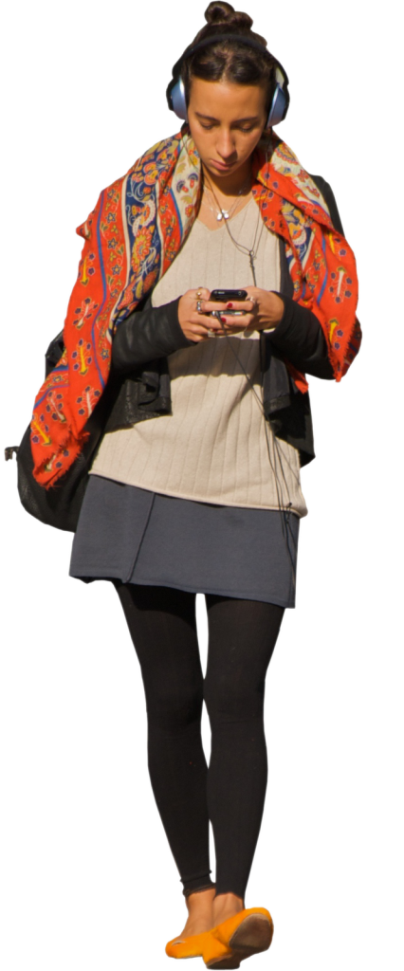
Awareness
The moment you go from the environment you control to one you don’t, you need to be alert. Have that mild sense of suspicion. Be Aware, not Paranoid
Cornerstone to personal safety
Be alert; know what’s going on around you
Pay attention to where you’re going, how you’re going to get there
Make Eye Contact
Awareness of body language, nonverbal communication – what are others projecting
Knowledge of issues in the area/neighborhood
The 5 A’s - © Obsidian Security Group, Inc. 2007
Notes:
The moment you go from the environment you control to one you don’t, you need to be alert. Have that mild sense of suspicion. Pay attention to where you’re going, how you’re going there, what you are going to be doing. Plan ahead, but be flexible.
Know what’s going on around you, who is around you. Pay attention
to your surroundings. Make eye contact. Let others know you
acknowledge their presence
What cars are normally in your neighborhood
Who regularly makes deliveries at work
Who the regular maintenance and cleaning people are at work
What is appropriate in our work area so we identify what isn’t
Issues in the area
Knowing neighbors/neighborhood. Location history
Known hazards? Known potential hazards?
What are the real concerns
Who’s around?
Body language, what they are projecting? Non-verbal communication

Slide 8

Assessment
A constant part of the cycle. As circumstances change, as awareness changes, your assessment changes.
What does this information mean to me?
How does this impact me?
How great is the risk?
How much at risk am I?
Based on assessment, what now?
  Stay fluid, Adapt
  Don’t get locked into a mind set or a particular pre-determined response
The 5 A’s - © Obsidian Security Group, Inc. 2007

Slide 9
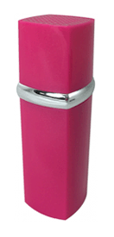
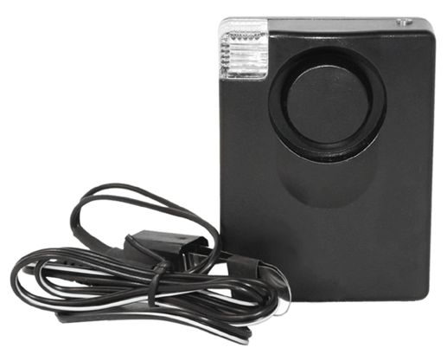

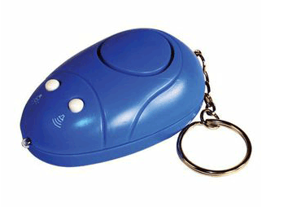
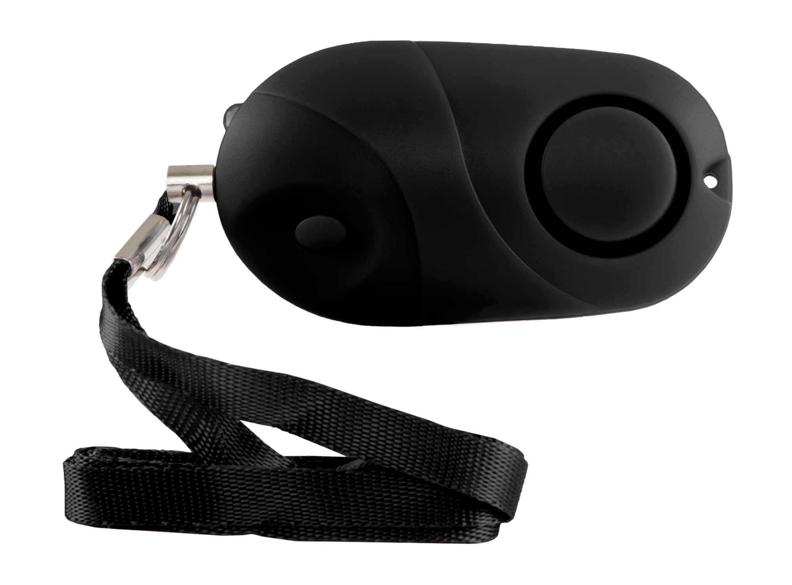
Action
Give Yourself Permission to Do Something
Trust Your Instincts
  “It’s okay to know without knowing why.”
  The Gift of Fear by Gavin De Becker
Assertiveness: Own your Personal Space
Do Something
  Avoid - Avoidance is an action.
    Go back inside, turn around, cross the street
  Seek help, tell somebody
  Walk away; Run
  Draw Attention
Personal Alarms
The 5 A’s - © Obsidian Security Group, Inc. 2007

Slide 10
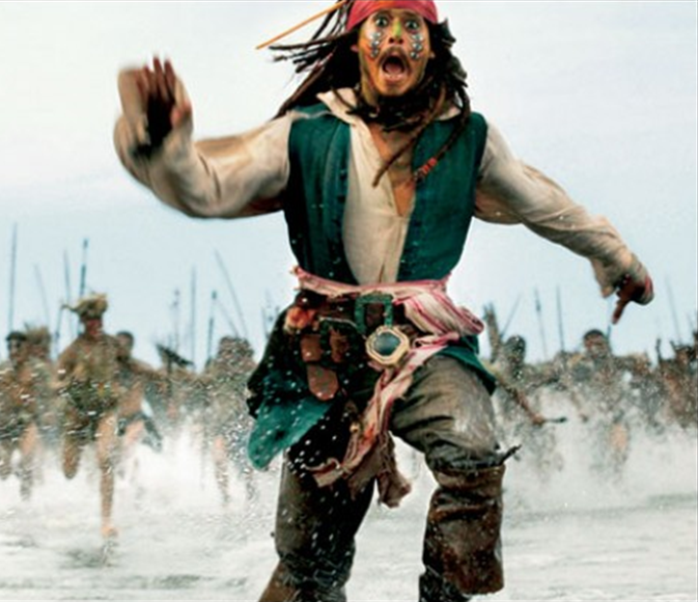
Action
Dude’s in Your Face
Assess
  Avenues of escape
  Available weapons
De-escalate
  Verbal, Non-verbal
Stance, body positioning
  What are you prepared to do?
  How are you positioned to respond?
Verbalize
  Your voice is a weapon, too
    “Stop!” “Back Up!” “Hey, what are you doing?” “No!!”
    Call for Help: “No! Help Police!! Help Police!!”
Distractions
  Hands to Face and Yell
  Hand full of change
Leave! Get Out, Get Away
The 5 A’s - © Obsidian Security Group, Inc. 2007
Notes:
Dude’s in Your Face
Assess when they are coming toward you:
Avenues of escape
Available weapons
De-escalation – verbal, non-verbal
Verbalization
Stop! Back Up!, Hey, what are you doing? Fire!
Stance, body positioning
What are you prepared to do?
How are you positioned to respond?
Distractions
Hand full of change

Slide 11
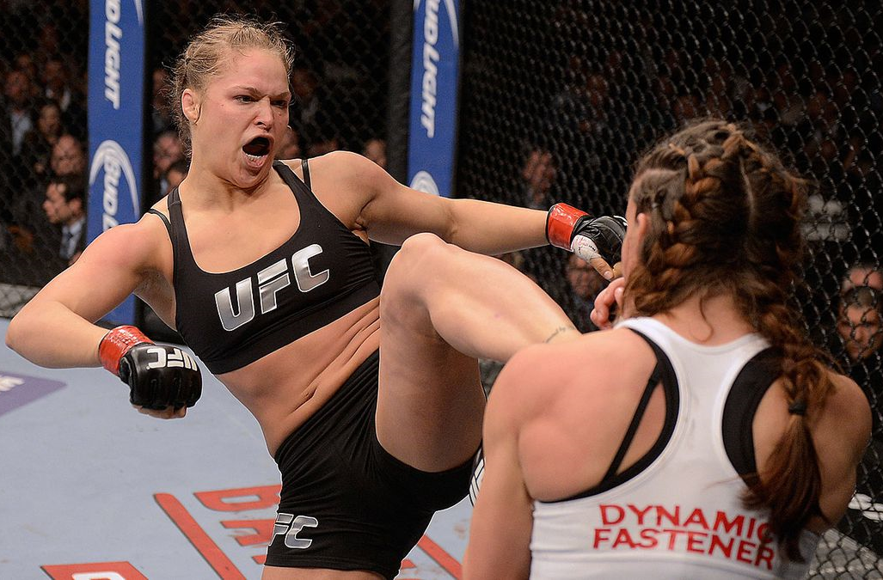
Action
Physical Violence is always the last resort
Mindset
Be Prepared: Know what to do and when to do it
  Under a high-stress situation you will fall back on the way you have prepared, good or bad!
Know that you are allowed to do to defend yourself or another
If attacked, take the fight to THEM!
The 5 A’s - © Obsidian Security Group, Inc. 2007
Notes:
Physical Violence is always the last resort.
When it gets to that point, it is the only option.
At this point, you need to be prepared and fully commit.
Mindset
When are you willing to fight?
What are you willing to fight for?
Are you willing to fight for yourself?
Knowing what to do and when to do it
Being able to do it without over-analyzing, over-processing, over-thinking. Muscle Memory.
Knowing what you are allowed to do to defend yourself or another
What the law allows/recognizes.

Slide 12

Action
If it’s about getting your stuff, cooperate;
you are more important than your stuff
If attacked, FIGHT FOR YOUR LIFE
  Know & accept that you may be injured
  Fight immediately, violently, quick, hard
  Fight to Win
First 15 seconds
Know your targets
  Eyes, throat, groin
Do not allow to be taken to a secondary location
The 5 A’s - © Obsidian Security Group, Inc. 2007
Notes:
Physical Violence is always the last resort.
When it gets to that point, it is the only option.
At this point, you need to be prepared and fully commit.
Mindset
When are you willing to fight?
What are you willing to fight for?
Are you willing to fight for yourself?
Knowing what to do and when to do it
Being able to do it without over-analyzing, over-processing, over-thinking. Muscle Memory.
Knowing what you are allowed to do to defend yourself or another
What the law allows/recognizes.

Slide 13
Use of Force Laws
Force is lawful when:
used by a party about to be injured, or by another lawfully aiding him or her, in preventing or attempting to prevent an offense against his or her person, or a malicious trespass, or other malicious interference with real or personal property lawfully in his or her possession, in case the force is not more than is necessary. [RCW 9A.16.020]
What are you allowed to do?
The 5 A’s - © Obsidian Security Group, Inc. 2007

Slide 14
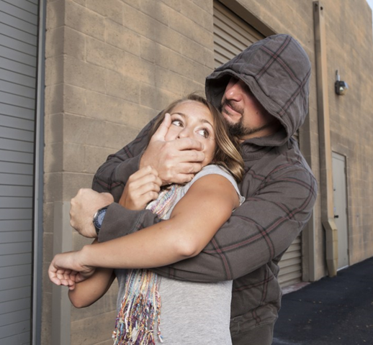
Use of Force Laws
The courts look at “reasonable” and “necessary.”
  Was the amount of force reasonable?
  Was the force necessary to effect the lawful purpose intended?
Case by case basis
  Can you kill someone who has just slapped you?
  Can you shoot someone breaking into your house?
The 5 A’s - © Obsidian Security Group, Inc. 2007

Slide 15
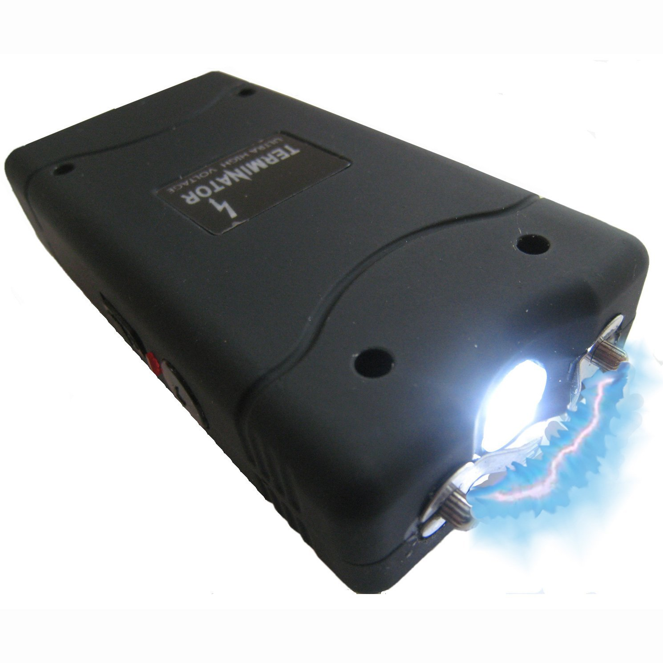
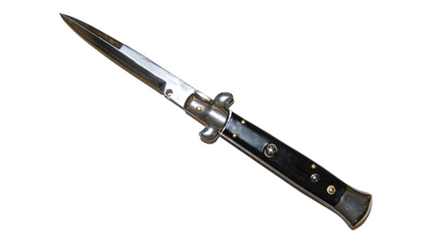
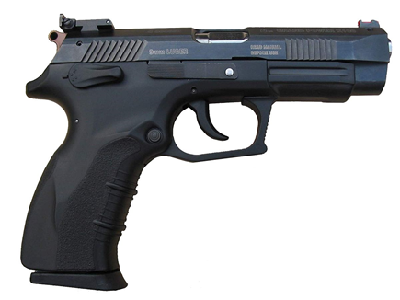
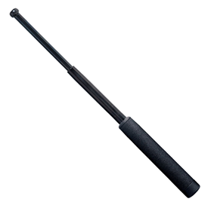

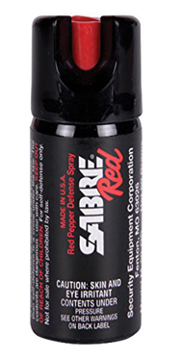
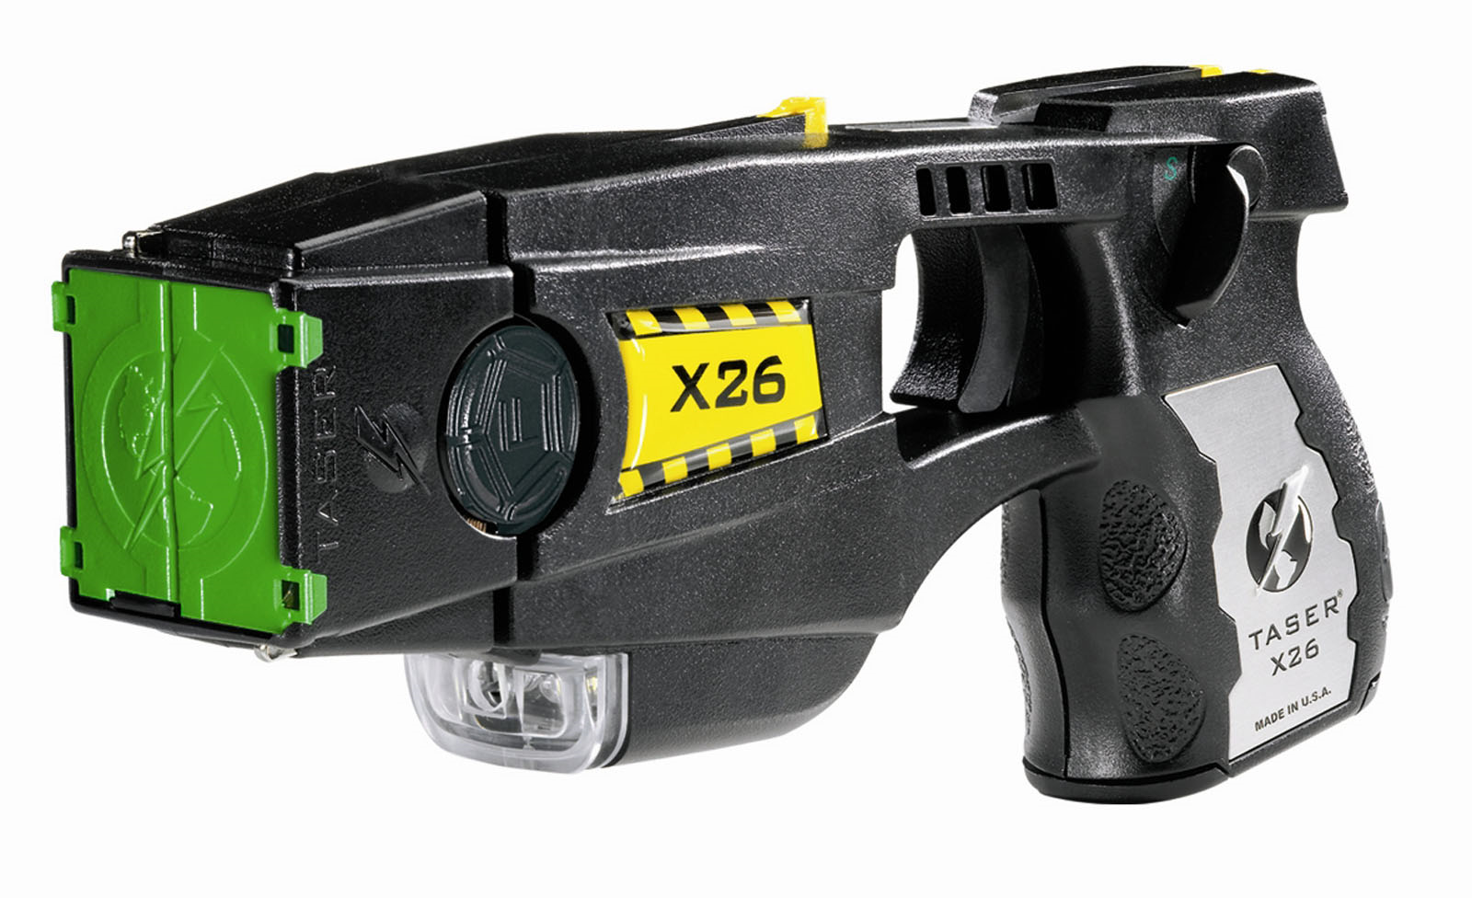
Let’s Talk Weapons
Knives
Stunners/Stun guns
Firearms
Batons/
Telescoping Batons
Wakandan Vibranium Pulse Gauntlets
(not commercially available)
Tasers
Pepper Spray/Mace
The 5 A’s - © Obsidian Security Group, Inc. 2007
Notes:
OC laws: possess at 16, purchase at 18. If you buy OC, buy two: practice in your backyard so you know how it comes out of the canister. You will get some on you if in a fight .
Knife laws.

Slide 16

Aftermath
After the Encounter, Moving Forward
Physical Safety
Immediate concern
Report
911: As detailed as possible
Preserving the Crime Scene
Telling your story
Questions from Police, Courts
Share information with others
Survivor – Things to Process
Questions
Emotions
Assistance is available
Don’t Blame Yourself – Not Your Fault
The 5 A’s - © Obsidian Security Group, Inc. 2007
Notes:
Regardless of the ultimate consequences, a survivor of a violent encounter has things to process, as well as further actions to take to bring closure to the situation.
After An Encounter
Your immediate concern should be for your physical safety
Reporting: Give good descriptions. If you don’t report, perpetrator may victimize someone else
If Sexual Assault : don’t shower, change clothes or disturb the crime scene. In sexual assault, you are the crime scene.
You will be asked detailed questions that may elicit painful memories.
The professionals involved know this.
It Is Not Your Fault
Questions a survivor may have:
What if it’s someone I know?
What did I do to cause this? Why Me?
How could I have stopped it?
Embarrassment, Fear, Shame
If You Are A Sexual Assault Survivor…
With sexual assault, remember that regardless of how much you’ve had to drink or how guilty you feel, a crime has been committed against you and you are the crime scene.
Role of police/Questions police may ask:
When did it happen?
Who was involved?
Were weapons involved?
What were the circumstances before and during?
What was the threat?
Evidence?
Role of court system/questions that might be asked (all of the above plus):
Was the force used necessary to eliminate the threat?
Is there a chargeable offense against the perpetrator?
Is there a cooperating victim and/or witness?
Histories of those involved?

Slide 17
Questions?

Slide 18
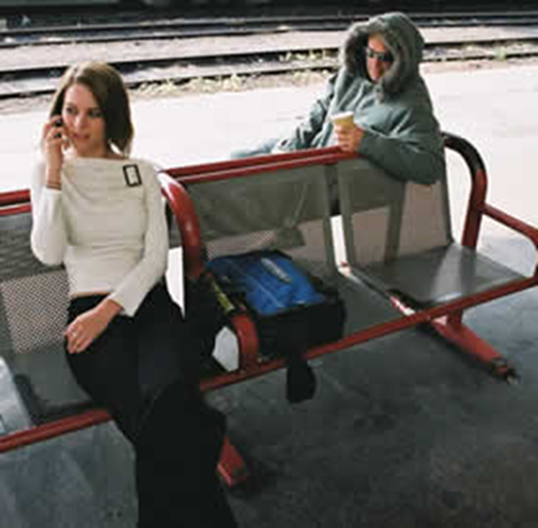
Safety Tips By Location or Activity
Safety Tips On The Street
Be aware of yourself and your surroundings
Be familiar with your frequently used routes
Always try to walk facing traffic
If you must walk alone, walk in the middle of the sidewalk, away from doorways & parked cars
If going to an unfamiliar area, get a map, directions and plan your route. Do not rely on a GPS unit alone.
The 5 A’s - © Obsidian Security Group, Inc. 2007

Slide 19
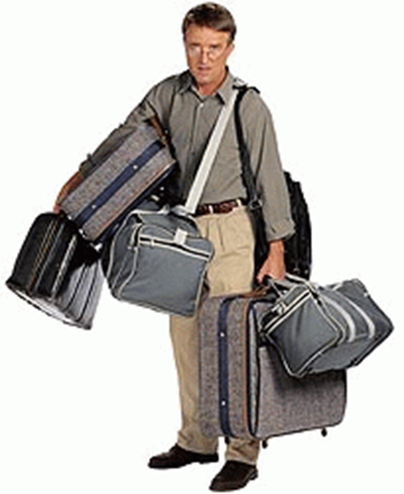
Safety Tips By Location or Activity
Safety Tips On The Street
Make eye contact with others
Consider clothing/shoes that you can run in
Maintain Positive control over your items
  Avoid Being Overloaded With Items
If you suspect you are being followed, turn and look; cross the street, walk to a safe location.
Never let anyone close the distance between you without your consent.
Scream or yell; Create a scene and bring the witnesses to you!
The 5 A’s - © Obsidian Security Group, Inc. 2007

Slide 20

Safety Tips By Location or Activity
Running/Jogging Tips
Take off your headphones!
Carry a cell phone with you
Vary your routine
Know some landmarks/streets if you need to call for help
Report suspicious activity!
The 5 A’s - © Obsidian Security Group, Inc. 2007

Slide 21

Safety Tips By Location or Activity
Driving Safety
Lock your doors as soon as you get in your car
Don’t fall prey to aggressive drivers and road rage
  Pull over and let them pass
  Call 911 if driving is dangerous
Get in the habit of leaving yourself room for escape
  Don’t tailgate, leave room in heavy traffic
  Can you see the wheels of the car in front of you?
The 5 A’s - © Obsidian Security Group, Inc. 2007

Slide 22
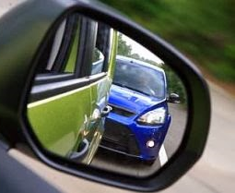
Safety Tips By Location or Activity
Driving Safety: Being Followed?
If you think you are being followed, head toward the nearest well lit business
Don’t drive home
Note the license plate and if possible the make and color of the car
Call 9-1-1
Do not pull over if a car behind you flashes its’ headlights. Police vehicles contain blue lights.
The 5 A’s - © Obsidian Security Group, Inc. 2007

Slide 23
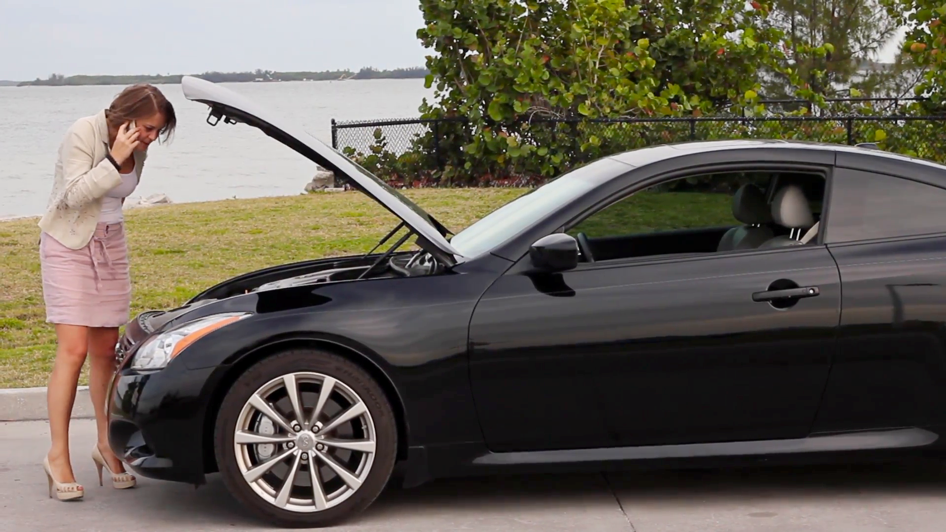
Safety Tips By Location or Activity
Car Trouble
Pull over to the side of the road, Turn on emergency flashers
You can call 9-1-1. Depending on the agency, will send a patrol car or call for a tow
If someone stops to help, ask them to call police
Keep an emergency kit in your car
The 5 A’s - © Obsidian Security Group, Inc. 2007

Slide 24
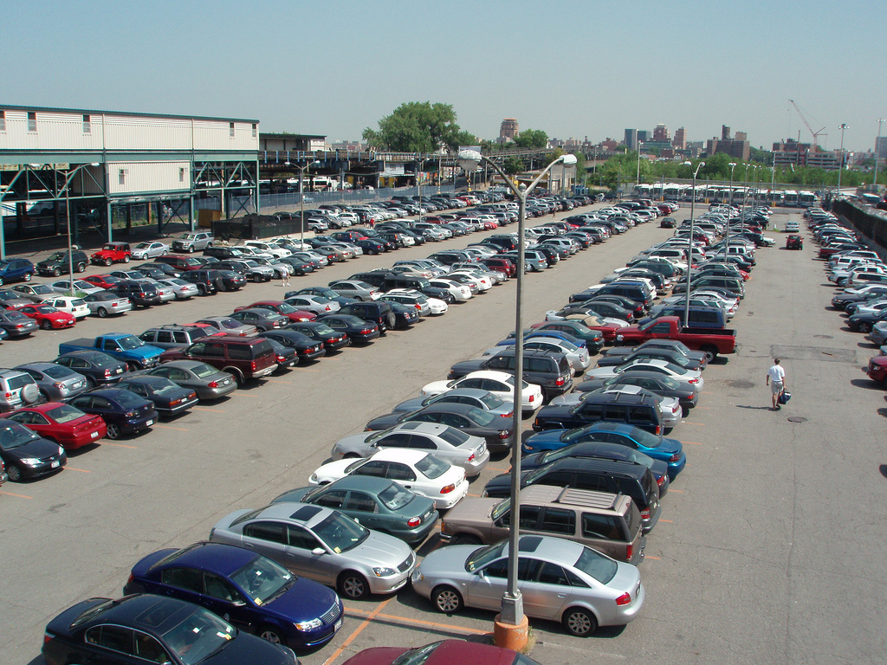
Safety Tips By Location or Activity
Shopping Malls and Parking Lots
These areas are prone to car prowls and auto thefts
  Don’t leave valuables in sight! Packages, Phones, Laptops, Bags, etc.
Park in well lit areas if possible
Ask security to walk you to your car - It’s their job
Get keys out and ready before getting to your car
Lock your door once inside the vehicle
Pay attention to the cars parked around and who is in them.
The 5 A’s - © Obsidian Security Group, Inc. 2007

Slide 25
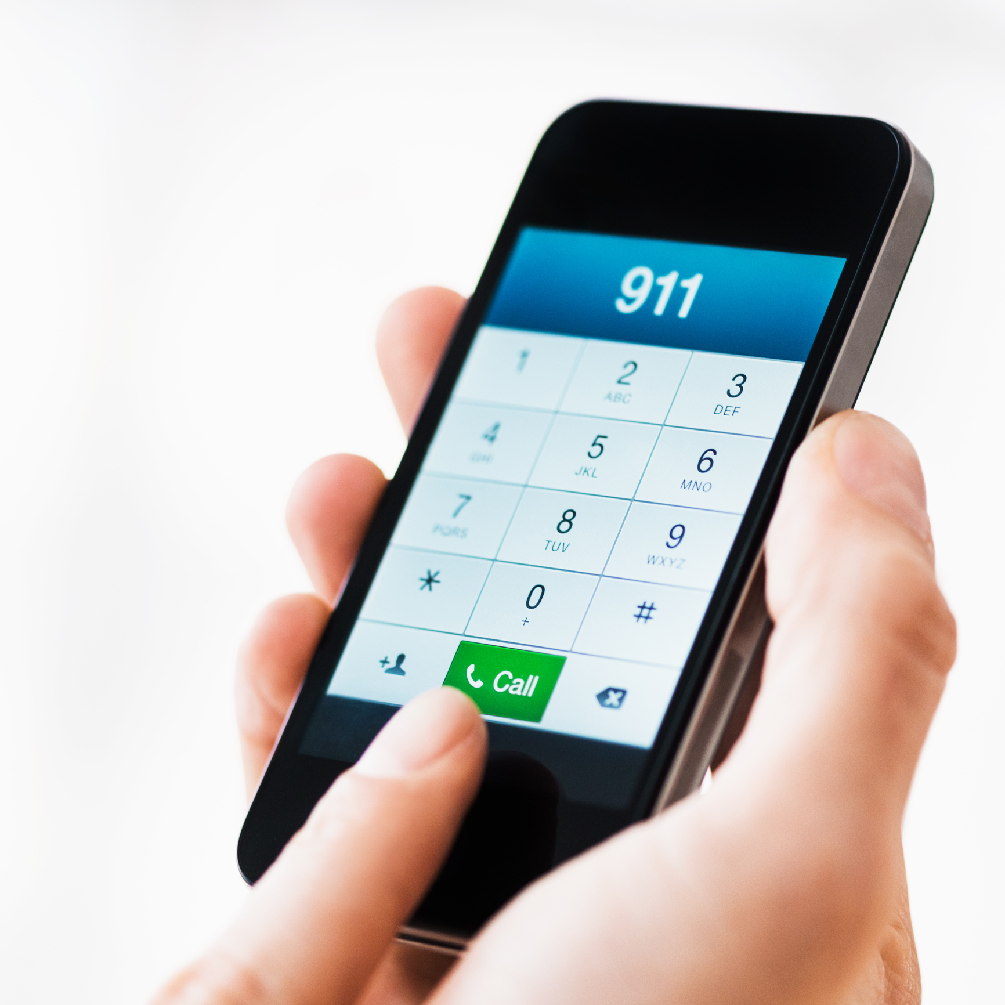
Reporting Crime
or Suspicious Behavior
It’s okay to call 911
  Non-emergency Numbers
Know where you are
  To connect with appropriate agency
State Emergency; If not an emergency, say so
Let the call taker control the conversation
  Police likely dispatched while questions are being asked
Be prepared to answer where, what, when, who, weapons
Be as detailed as possible
Don’t hang up
  Stay on the line until call taker tells you it’s okay to hang up
The 5 A’s - © Obsidian Security Group, Inc. 2007

Slide 26
Personal Safety Summary
Project a sense of purpose
Don’t project “target” or “victim”
Realize you have options
Don’t always have to do what you started out to do
Carry minimal possessions
Take just what you need for what you are doing
Stay alert! Pay attention to the present moment
Have a plan! Planning ahead may help you get through a situation unharmed
Trust your instincts! Don’t ignore early danger signals
Report!
Notes:
Realize you have options
Don’t always have to do what you started out to do
Project a sense of purpose
Don’t project “target” or “victim “
Carry minimal possessions
Take just what you need for what you are doing
Stay alert!
Anytime you go from an environment you control to one you don’t, it is in your best interest to maintain a mild state of suspicion. Pay attention to the present moment.
Trust your instincts!
Don’t ignore early danger signals. If a situation appears unsafe, look for avenues of escape. It’s okay to leave.
Have a plan!
Think about how you would respond to a confrontation or attack. Planning ahead may help you get through an emergency unharmed.

Slide 27
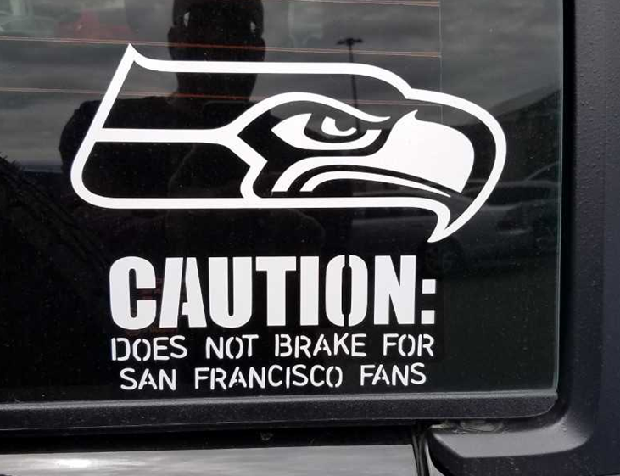
Questions?
Mark A. Solomon, CPD
Crime Prevention Coordinator, Seattle Police Department
(206)679-1162 mark.solomon@seattle.gov

