Slide 1

April 24, 2018
ADA Issues & Solutions Workshop 2018
Personal Safety:
In The Workplace
In The Field
Mark Solomon, CPD
Crime Prevention Coordinator
Seattle Police Department

Slide 2
Workshop Overview
Needs Assessment – your safety concerns
Safety In The Work/Office Environment
Safety In The Field
Worst Practices/Best Practices

Slide 3
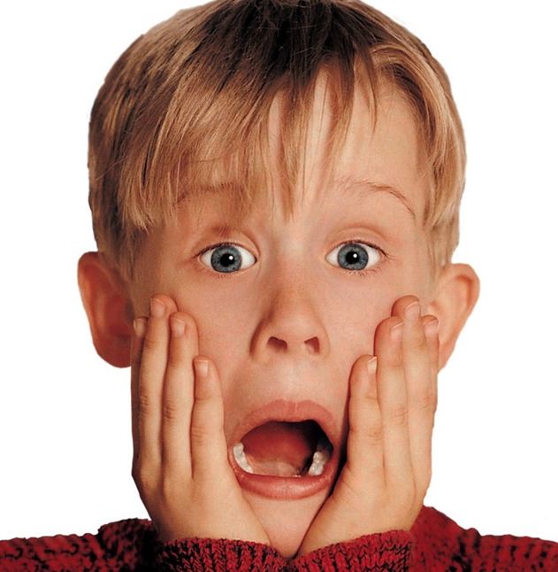
Needs Assessment
What are your safety concerns?

Slide 4
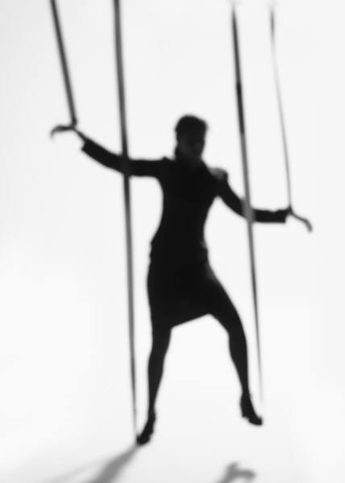
Spheres of Control and Influence
Those over which you have direct control
Those things that you can influence, but have no direct control
Big picture – things outside of your direct sphere of control
Question: How do you ensure your safety when you go from an environment you control to one you don’t?

Slide 5
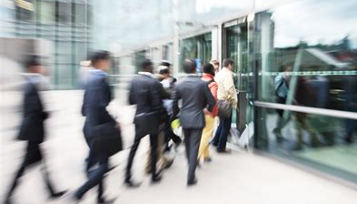
Enhancing Your Safety
In The Work/Office Environment
Getting There
Park in well-lit, good visibility areas
Take a “visible” path
Be aware of other people in the area
Ensure no unauthorized person enters a secure part of the building with you
Is there anything that doesn’t look/feel right? Go with your “gut” feeling

Slide 6

Enhancing Your Safety
In The Work/Office Environment
Physical security of office environment
  Office layout (access points, exits, physical barriers, blind spots/corners)
Policies and procedures
  Unknown/unauthorized persons?
  Use of ID Badges?
  Emergency protocols?
Meeting with public
  What does your gut say?
  Use of meeting/interview rooms
  How/where do you sit?
  Communications – Code words?

Slide 7

Enhancing Your Safety
In The Field
Planning and Preparation
Where are you going?
  Location history, possible hazards
  Urban, Suburban or Rural?
  Ingress/Egress Routes – Map it/Plan it
Hours – When are you going?
Transportation – How getting there
  Personal vehicle, Company vehicle, Public Transit
Who are you meeting with?
  History? Any Red Flags?
Dress/attire and shoes – can you move, run?
Jewelry and accessories – “breakaway” IDs
Do you have proper gear? What do you need?
Notes:
Most vulnerable time is on their “home field”
Planning & Preparation
Hours you will be working
Your transportation
Dress/Attire, type of clothing that you’ll need - think safety first!
Shoes - can you realistically run in them?
Pay attention to jewelry, accessories; don’t set yourself up to be
a victim
Location history
Client history; gives best idea of how clients will react
Map property for possible hazards
Suggested Items for the field:
Tape Measure
Flashlight
Camera
Notepad
Tape recorder or recording devise
Cell Phone
Phone number list
Other forms

Slide 8
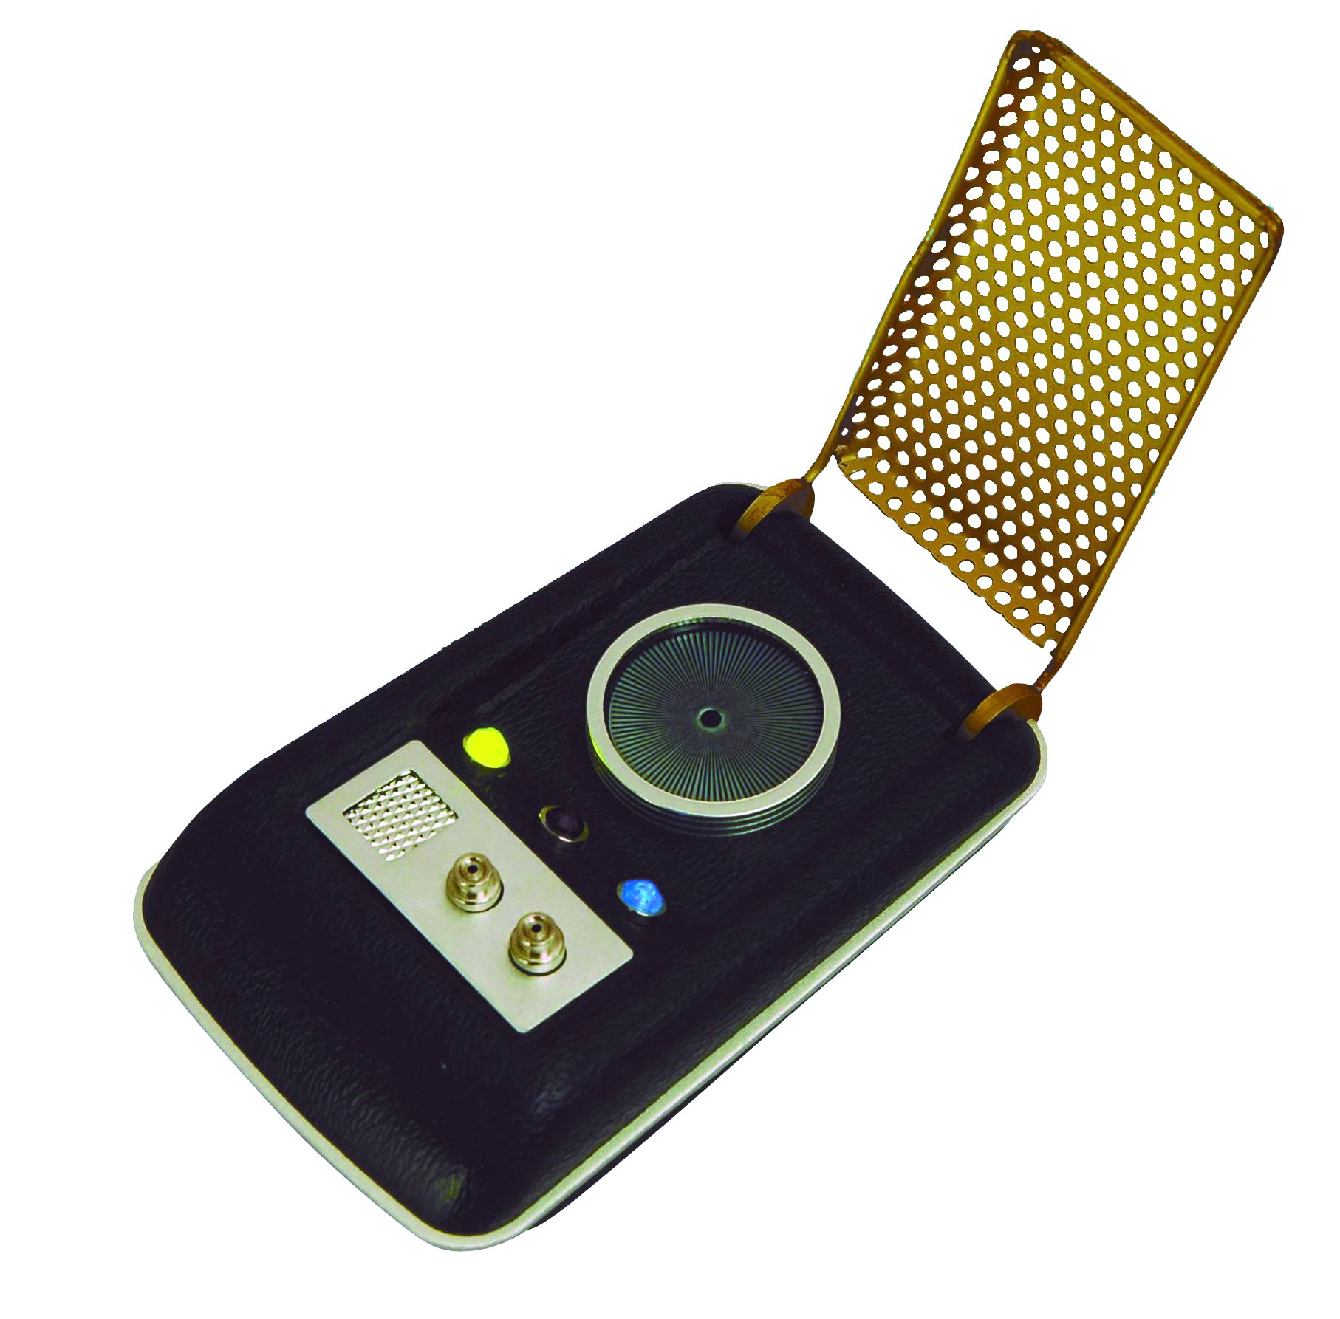
Enhancing Your Safety
In The Field
Planning and Preparation
Communication
  Who knows where you are/who you’re with?
    Ensure colleague or office knows location, times on site, expected return
  Pre-arranged status checks
Notes:
Most vulnerable time is on their “home field”
Planning & Preparation
Hours you will be working
Your transportation
Dress/Attire, type of clothing that you’ll need - think safety first!
Shoes - can you realistically run in them?
Pay attention to jewelry, accessories; don’t set yourself up to be
a victim
Location history
Client history; gives best idea of how clients will react
Map property for possible hazards
Suggested Items for the field:
Tape Measure
Flashlight
Camera
Notepad
Tape recorder or recording devise
Cell Phone
Phone number list
Other forms

Slide 9
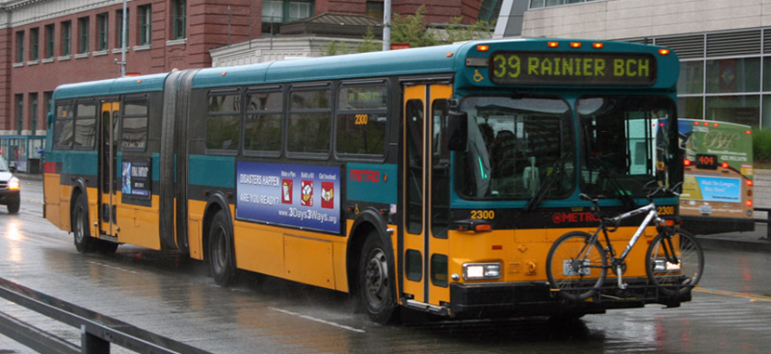
Enhancing Your Safety
In The Field
While In Transit
If Using Public Transportation
  Be Aware; minimize distractions
  Let others know you area aware: eye contact, acknowledgement
  Minimize personal belongings
  Maintain positive control over your items
    Avoid being overloaded with items

Slide 10
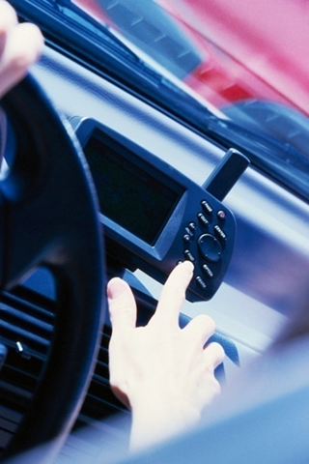
Enhancing Your Safety
In The Field
While In Transit
If Driving
  Ensure vehicle is in good mechanical condition, well maintained
  Keep gas tank ¾ full when possible
  Keep items out of sight or place in trunk
  Minimize personal belongings
  If using your personal vehicle, keep in mind that who you are meeting with will know what you drive

Slide 11
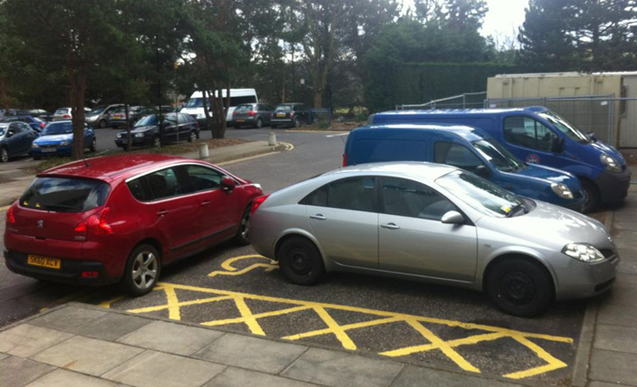
Enhancing Your Safety
In The Field
Arriving At Your Destination
Don’t just pull right in to the location
  Take the extra time to observe
Drive up slowly, but not too slow
  Give them “transition” time
Park so you can leave unimpeded
  Never park so your vehicle is blocked from leaving
Take your time at vehicle before going in
  Gives them more transition time
  Gives you time to scope out environment, scan your surroundings
  Pay attention to warning signs – Listen to your gut
    What do you See? Hear? Smell?
Plan for a quick departure if necessary

Slide 12

Enhancing Your Safety
In The Field
At Your Destination
On their “Home Field”
  An Environment They Control
Note ingress/egress points
Who is present?
  Ask if anyone else will be joining you
Scan Your Surroundings
  Note items that could be used as weapons
    Knives, other kitchen utensils
    Sports equipment
    Tools, fireplace tools
    Office supplies (pens, letter openers, paperweights, etc.)
Be cognizant of where you sit; consider if you sit
  Keep your knees lower than your hips
  Do you have unimpeded pathway to exit?

Slide 13
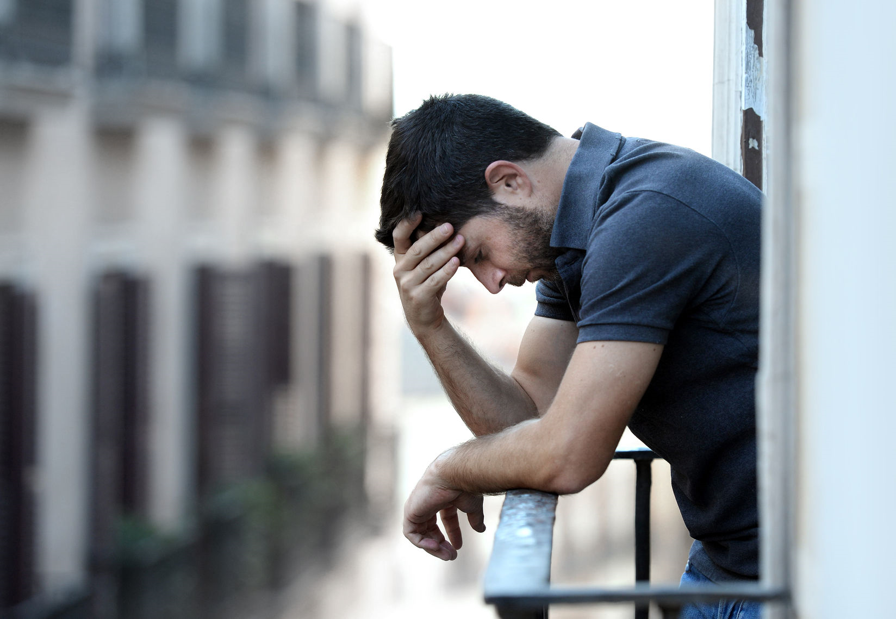
Enhancing Your Safety
In The Field
Some Factors That Could Affect Client’s Behavior
Death in the Family
Removal of Child(ren)
Recent Arrest
Change in medications
Illness
Loss of Job or benefits
Might not hurt to Check In up front

Slide 14
Questions?

Slide 15
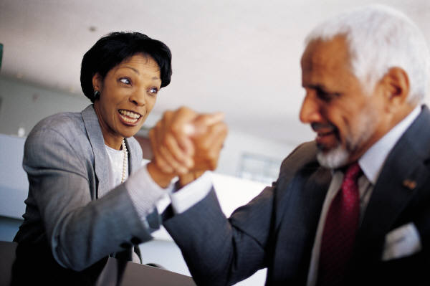
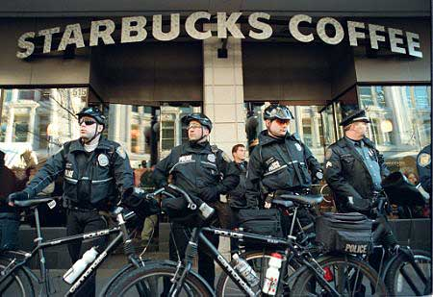
Workplace and Staff Safety/Security
Best and Worst Examples
Examples that will stimulate ideas of what didn’t work, what can work, and what would be appropriate for your situation

Slide 16
Worst Practices Examples
Ineffective Emergency Action Plan
Company whose emergency plan consisted of a 1½ page fire drill procedure; didn’t ask themselves what else needed to be there
Lack of Staff Knowledge Regarding Security Protocols
Agency had panic alarm protocols; no one knew them, practiced them or knew their role in the event of panic alarm activation
Unknown Persons in the Work Environment
Government entity that had an unknown person come in to a “secured” area unchallenged, steal someone’s wallet and depart unchallenged

Slide 17
Best Practices Examples
Effective Emergency Action Plan
Complete Risk Assessment, review of all practices and procedures, Revision, updating of safety & security protocols
    Receptionist as gatekeeper, visible IDs, challenged unknown persons, better safeguarding of network passwords, employee in-service trainings, Included actions regarding DV situation
Staying Safe in the Field – Realtors
Real estate safety guide; Open-House procedures
  pre-screening clients (making copy of ID before going out with client, customer ID forms), Agent ID forms; Knowledge of who/when/where; Duress words
Involving Staff
Safety Committee; involved in writing procedures, protocols, involved in action steps when need arises
Staff In-service trainings that go into personal safety details
  1-4 hours in length depending on need, concern

Slide 18

Another Best Practice - Reporting
Impart to staff
If there’s a threat, tell someone
If it’s suspicious, tell someone
If you’re not sure, tell someone
It’s okay to call 911
Also need to tell Supervisor, coworkers;
Alert others to threat
Describe in detail as best you can
Two key elements to giving a good report:
  Accuracy
  Timeliness
Message to Staff - When reporting suspicious activity:
Never endanger yourself
Never confront suspicious activity
Report Immediately

Slide 19
Enhancing Your Safety In The Field
Summary
Options
  If a situation feels unsafe – if your gut tells you something isn’t right – know you can do something about it - Action!
    Meet at a different location where there are other people (local coffee shop for example)
    Reschedule or cancel the appointment
Partners
  Have a colleague join you so you are not alone
    Having a partner effects your area of control
Refer client to another colleague
  Let colleague know why you’re pawning the person off
Debrief
  Share experiences you’ve had so colleagues are also aware; learn from each other

Slide 20
Enhancing Your Safety In The Field
Summary
Planning And Preparation Will Minimize Your Risks
Give Yourself Permission To Act
  Trust yer gut! If your gut says get out – leave
  Your safety is more important than their feelings

Slide 21

Questions?
Mark A. Solomon, CPD
Crime Prevention Coordinator, Seattle Police Department
(206)679-1162 mark.solomon@seattle.gov

Slide 22

Thank You For Your
Time & Attention
Personal Safety:
In The Workplace
In The Field

